Slide 1

Summer Internship Project
Hands On Android Application Development
Learning And Implementing the Features of Android Studio

Slide 2

Technology Stack
Android Studio : Android Studio is the official integrated development environment for Android application development. It is based on the Java integrated development environment for software, and incorporates its code editing and developer tools.
Android Studio uses a Gradle-based build system, Android Studio, code templates, and Github integration.

Slide 3

Build apps fast, without managing infrastructure
Firebase gives you functionality like analytics, databases, messaging and crash reporting so you can move quickly and focus on your users.

Slide 4

Firebase as a Real Time Database
The Firebase Realtime Database is a cloud-hosted NoSQL database that lets you store and sync data between your users in Realtime.
Realtime Database uses JSON format for storing values.

Slide 5
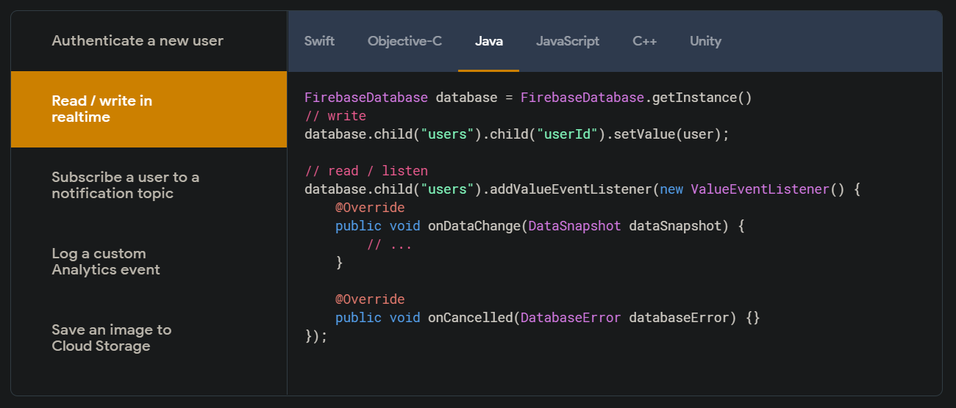
Firebase in action
Any time you read data from the Database, you receive the data as a Data Snapshot. A Data Snapshot is passed to the event callbacks you attach with on() or once().
You can extract the contents of the snapshot as an object by calling the val() method. Alternatively, you can traverse into the snapshot by calling child() to return child snapshots (which you could then call val().
A Data Snapshot is an efficiently generated, immutable copy of the data at a Database location. It cannot be modified and will never change (to modify data, you always call the set() method on a Reference directly).

Slide 6
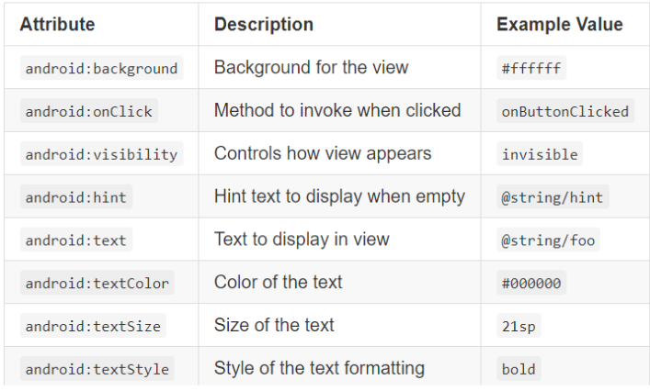
App Styling Components

Slide 7
Work Flow..
Login/Signup
Questions
Result

Slide 8
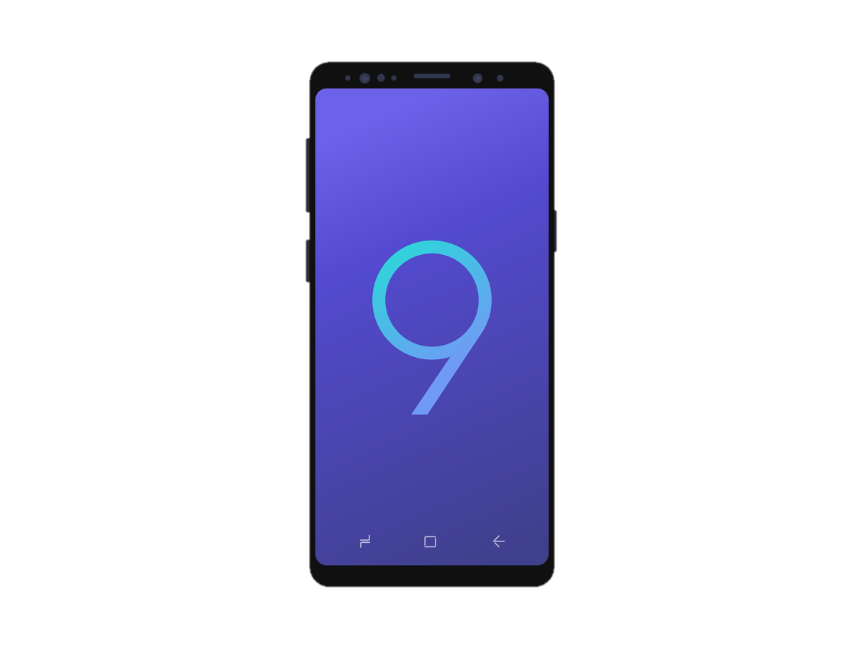

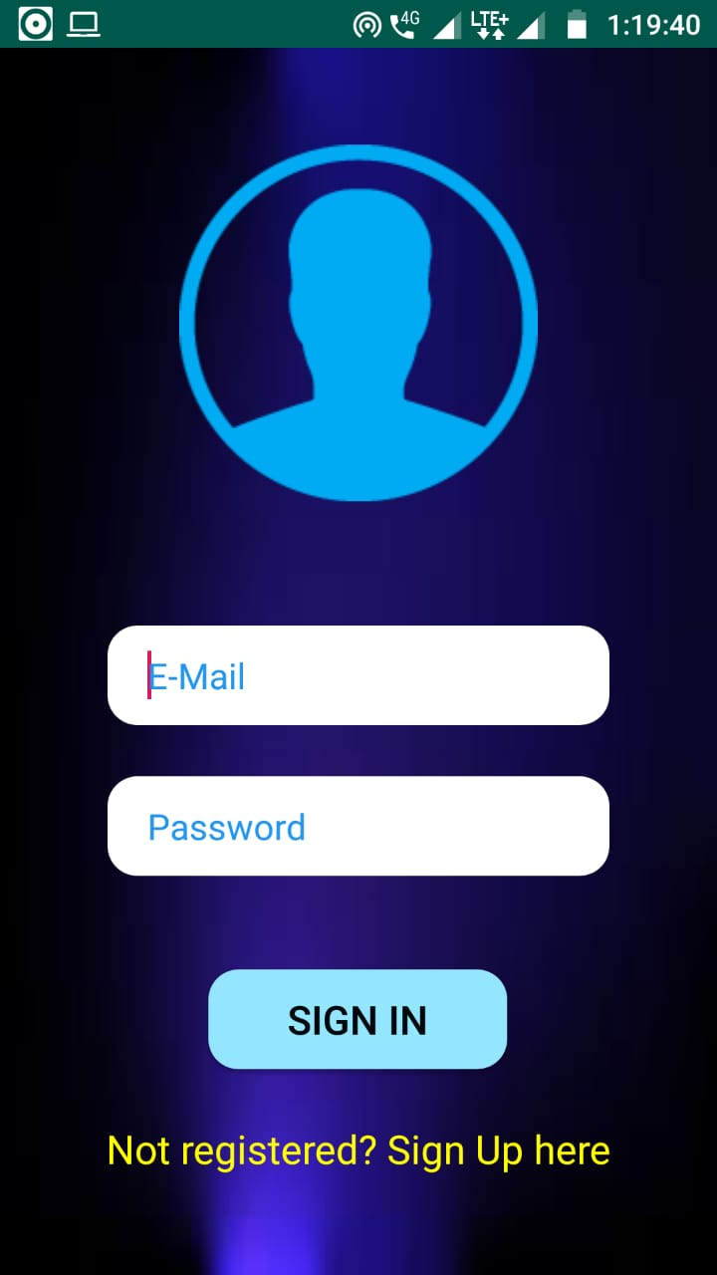
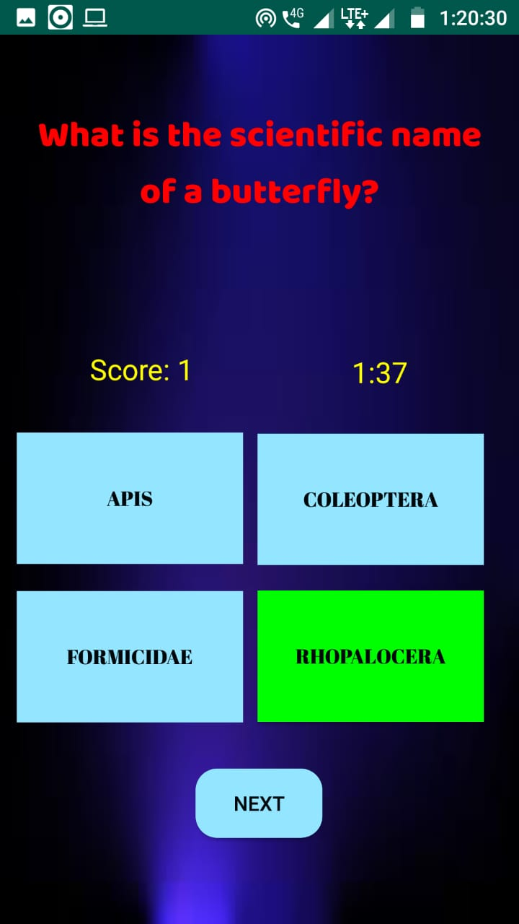
Final View

Slide 9

Thanks

